Slide 1


Group Commands
Authors:
Yoav Rozov

Slide 2

Instant Command

Slide 3
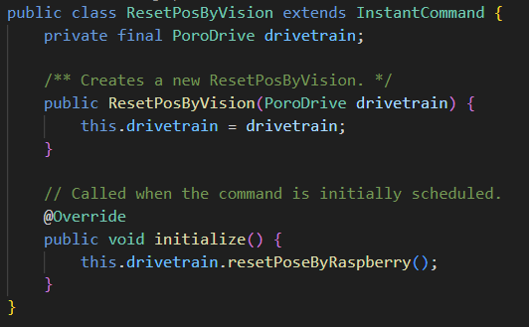
Instant commands
Instant commands are a type of command where there is no execute method and the command ends right after the initialize method finishes.
They are used for simple commands where there is no need to use the execute method for example: ResetPosByVision

Slide 4
Command Compositions
Source: WPILib

Slide 5
Why?
Individual commands can accomplish a large variety of robot tasks, but the simple three-state format can quickly become cumbersome when more advanced functionality requiring extended sequences of robot tasks or coordination of multiple robot subsystems is required.
For example, if we want to intake a note we need to:
Open intake -> activate rollers -> close intake and stop rollers when a note is detected -> move angler -> activate angler rollers -> activate intake rollers -> stop angler rollers when a note is detected.
This long sequence of commands is very hard to do in one single command, so we use command groups
Notes:
https://docs.wpilib.org/en/stable/docs/software/commandbased/command-compositions.html

Slide 6
Command groups types
There are 4 types of command groups:
SequentialCommandGroup - runs a list of commands in sequence - the first command will be executed, then the second, then the third, and so on until the list finishes. The sequential group finishes after the last command in the sequence finishes.
ParallelCommandGroup - runs a set of commands concurrently - all commands will execute at the same time. The parallel group will end when all commands have finished.
ParallelDeadlineGroup - also runs a set of commands concurrently. However, the deadline group ends when a specific command (the “deadline”) ends, interrupting all other commands in the group that are still running at that point.
ParallelRaceGroup - it runs a set of commands concurrently. However, the race group ends as soon as any command in the group ends.
Notes:
https://docs.wpilib.org/en/2022/docs/software/commandbased/command-groups.html

Slide 7
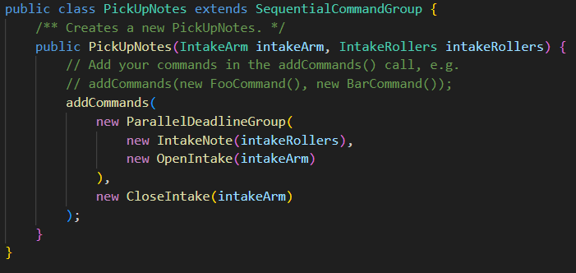
Code Implementation
We create a new command group using right click -> create new class command -> and selecting the correct command group type
All the code is written inside the constructor, we use the addCommands() function and give as inputs different commands.
Because all commands types extend the Command class, we can also create new command groups inside the addCommands method.

Slide 8
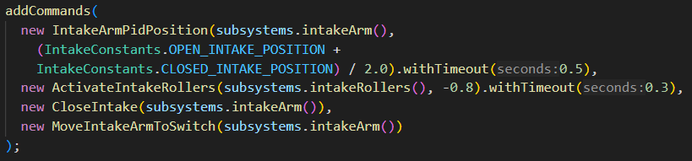
Code Implementation - helper functions
Every command we add has some helper functions to helps us determine simple logic and make life easier, for example:
.onlyIf(Boolean-supplier)
.onlyWhile(Boolean-supplier)
.andThen(Command)
.wait(long)
.withTimeout(double)

Slide 9
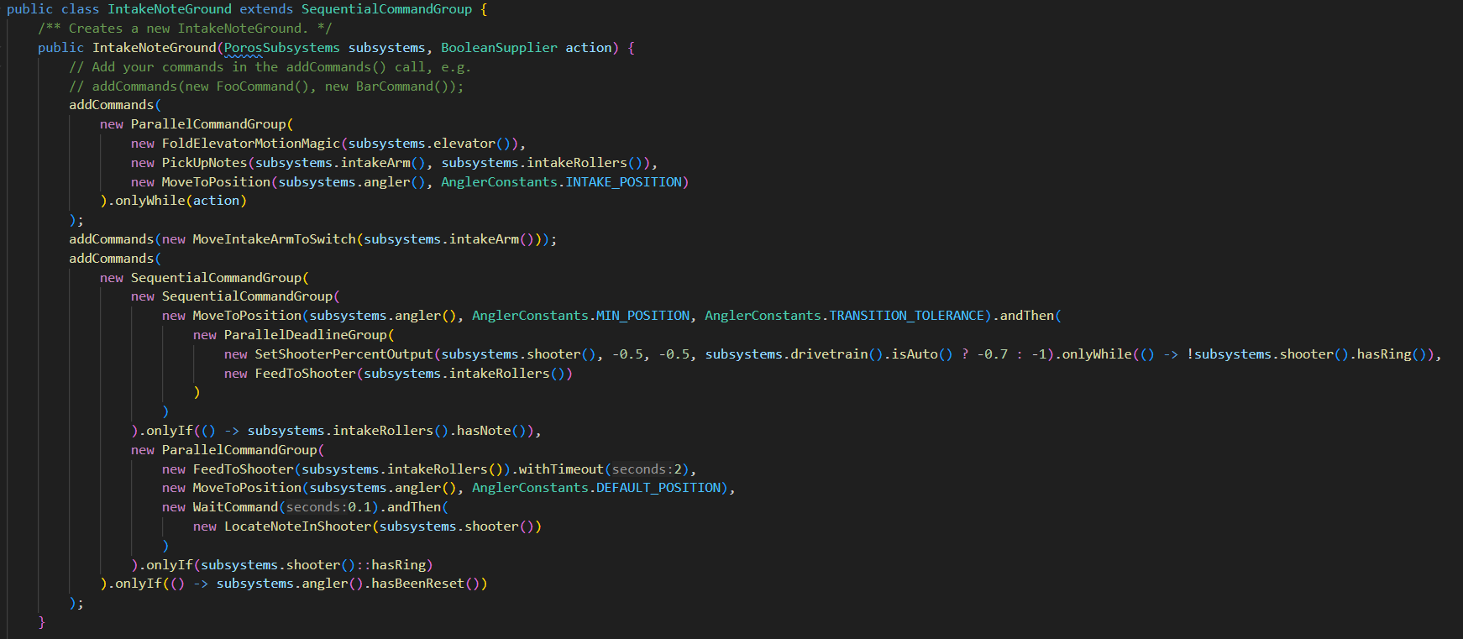
More complex example

Slide 10
Coding conventions
We will be using only SequentialCommandGrpup as the main class type (If we want a different command group, we create it inside the add commands method)
Every command group will be using the addCommands method only once
Try to avoid using to much helper functions (like .onlyIf)

Slide 11
תודה על ההקשבה

